Slide 1
Programming with Java

Slide 2
Why Use Java ?
Java is a popular programming language, developed by James Gosling at Sun Microsystems Inc in the year 1995, later acquired by Oracle Corporation.
It is owned by Oracle, and more than 3 billion devices run Java.
Java makes writing, compiling, and debugging programming easy.
It helps to create reusable code and modular programs.
Java is a class-based, object-oriented programming language and is designed to have as few implementation dependencies as possible.
A general-purpose programming language made for developers to write once run anywhere that is compiled Java code can run on all platforms that support Java.
Java applications are compiled to byte code that can run on any Java Virtual Machine.
It is open-source and free.
It is secure, fast and powerful.
It has a huge community support (tens of millions of developers).

Slide 3
Application Areas Where Java is Used:
1) Standalone Application
Standalone applications are also known as desktop applications or window-based applications. These are traditional software that we need to install on every machine. Examples of standalone application are Media player, antivirus, etc. AWT and Swing are used in Java for creating standalone applications.
2) Web Application
An application that runs on the server side and creates a dynamic page is called a web application. Currently, Servlet, JSP, Struts, Spring, Hibernate, JSF, etc. technologies are used for creating web applications in Java.
3) Enterprise Application
An application that is distributed in nature, such as banking applications, etc. is called an enterprise application. It has advantages like high-level security, load balancing, and clustering. In Java, EJB is used for creating enterprise applications.
4) Mobile Application
An application which is created for mobile devices is called a mobile application. Currently, Android and Java ME are used for creating mobile applications.

Slide 4
Java Editions:
1) Java SE (Java Standard Edition)
It is a Java programming platform. It includes Java programming APIs such as java.lang, java.io, java.net, java.util, java.sql, java.math etc. It includes core topics like OOPs, String, Regex, Exception, Inner classes, Multithreading, I/O Stream, Networking, AWT, Swing, Reflection, Collection, etc.
2) Java EE (Java Enterprise Edition)
It is an enterprise platform that is mainly used to develop web and enterprise applications. It is built on top of the Java SE platform. It includes topics like Servlet, JSP, Web Services, EJB, JPA, etc.
3) Java ME (Java Micro Edition)
It is a micro platform that is dedicated to mobile applications.
4) JavaFX
It is used to develop rich internet applications. It uses a lightweight user interface API.

Slide 5


Installing Java
Some PCs might have Java already installed.
To check if you have Java installed on a Windows PC, search in the start bar for Java or type the following in Command Prompt (cmd.exe):
If Java is installed, you will see something like this (depending on version):
If you do not have Java installed on your computer, you can download it for free at oracle.com.
NOTE: We can write Java code in a text editor. However, it is possible to write Java in an Integrated Development Environment, such as IntelliJ IDEA, NetBeans or Eclipse, which are particularly useful when managing larger collections of Java files.

Slide 6
Java Path Setup
The path is required to be set for using tools such as javac, java, etc.
If you are saving the Java source file inside the JDK/bin directory, the path is not required to be set because all the tools will be available in the current directory.
However, if you have your Java file outside the JDK/bin folder, it is necessary to set the path of JDK.
Setting Java Path
Go to Control Panel > System and Security > System > Advanced System Settings
Click on the "Environment variables" button under the "Advanced" tab
Then, select the "Path" variable in System variables and click on the "Edit" button
Click on the "New" button and add the path where Java is installed, followed by \bin. By default, Java is installed in C:\Program Files\Java\jdk-11.0.1 (If nothing else was specified when you installed it). In that case, You will have to add a new path with: C:\Program Files\Java\jdk-11.0.1\bin
Then, click "OK", and save the settings
At last, open Command Prompt (cmd.exe) and type java -version to see if Java is running on your machine

Slide 7
Two ways of using Java
Java
Source Code
Java Compiler
Applet Type
Application Type
Java Enabled Web Browser
Java Interpreter
Output
Output

Slide 8
Sample Java Program
Class SampleOne
{
Public Static Void Main(String args[])
{
System.out.println(“Java is better than C++”);
}
}
static
  the main method belongs to the SampleOne class, and not a part of any objects of the class

Slide 9
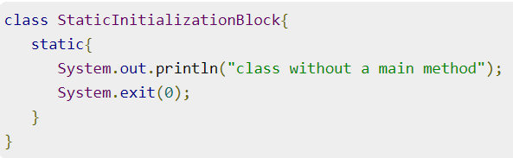
Can One Run Java Program Without Main() Method?
Yes, we can execute a java program without a main method by using a static block.
Static block in Java is a group of statements that gets executed only once when the class is loaded into the memory by Java ClassLoader, It is also known as a static initialization block. Static initialization block is going directly into the stack memory.
Note: In the above example, we can execute a java program without a main method (works until Java 1.6 version). Java 7 and newer versions don’t allow this because JVM checks the presence of the main method before initializing the class.

Slide 10
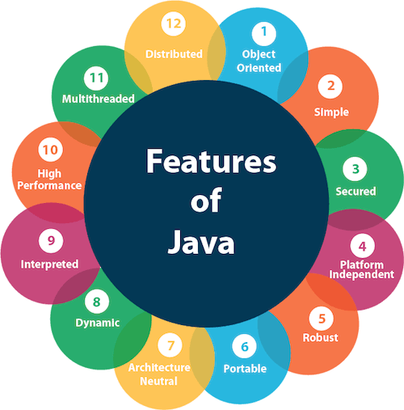
Features of Java
High variety of features, that’s why java is so popular.

Slide 11
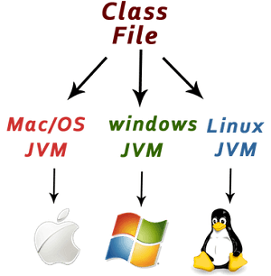
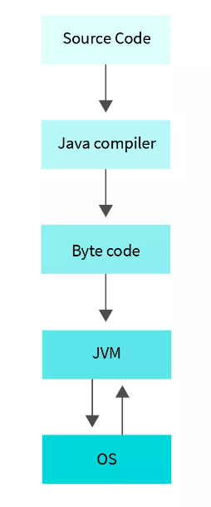
Features of Java
1. Platform Independent:
Compiler converts source code to bytecode and then the JVM executes the bytecode generated by the compiler.
This bytecode can run on any platform be it Windows, Linux, or macOS which means if we compile a program on Windows, then we can run it on Linux and vice versa.
Each operating system has a different JVM, but the output produced by all the OS is the same after the execution of bytecode.
That is why we call java a platform-independent language.

Slide 12
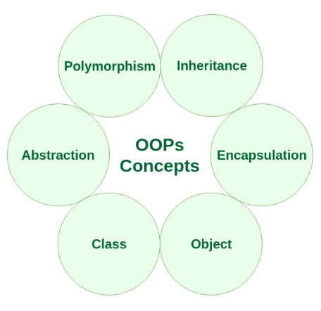
Features of Java
2. Object-Oriented Programming Language: Organizing the program in the terms of collection of objects is a way of object-oriented programming, each of which represents an instance of the class.
Let's understand this with the help of a real-life example:
We all know that under the Class of Cars we have a lot of options like Alto, WaganR, Santro, etc. and all these are individual objects altogether. In this manner, each Car object has its specific Model, Colour, Engine power, Top Speed, Year of Manufacture, etc. Which are altogether called the properties of the Car Class and the functions performed by it like Start, Stop, Move, etc are the methods of this Car Class. No memory is allocated on the creation of a class, but we allocate memory when the object is created which in our case is a new car object.

Slide 13
Features of Java
Object Oriented Features
Inheritance
Inheritance can be defined as an object acquiring all the behaviors and properties of a parent object.
The idea behind inheritance in Java is that you can create new classes that are built upon existing classes. When you inherit from an existing class, you can reuse methods and fields of the parent class.
It makes our code reusable.
Runtime polymorphism (Method Overriding) can be achieved using inheritance.

Slide 14
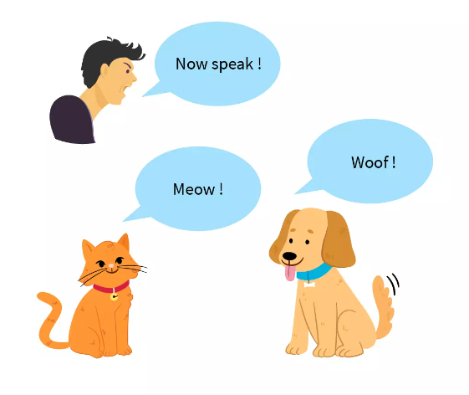
Features of Java
Object Oriented Features
Inheritance : An Example
Here the voices of everyone including the animals and the humans are inherited by their parents, the dog barks like a dog and the human speak like his parents. so here we can see a real-life example of inheritance.

Slide 15
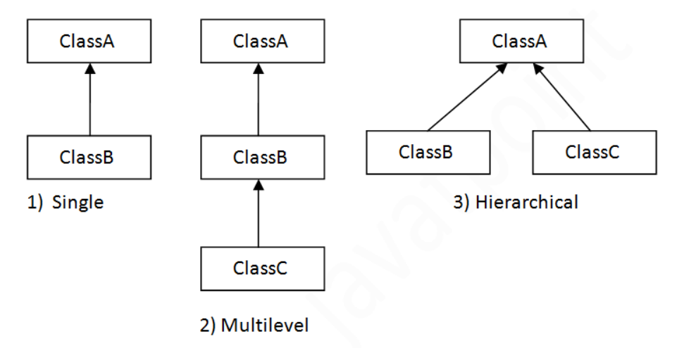
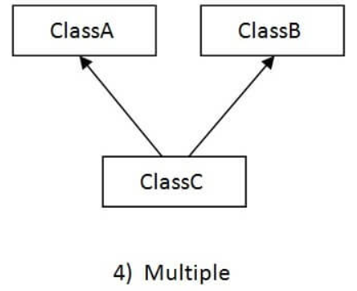
Features of Java
Types of Inheritance in Java:
Three types of inheritance in java: single, multilevel and hierarchical.
When one class inherits multiple classes, it is known as multiple inheritance.
Note: Multiple inheritance is not supported in Java through class.

Slide 16
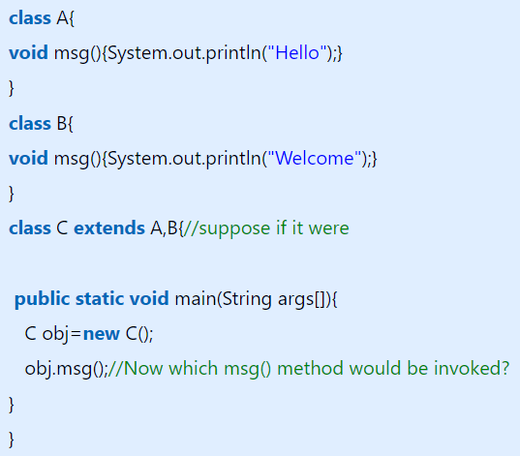
Features of Java
Why multiple inheritance is not supported in java?
To reduce the complexity and simplify the language, multiple inheritance is not supported in java.
Consider a scenario where A, B, and C are three classes. The C class inherits A and B classes. If A and B classes have the same method and you call it from child class object, there will be ambiguity to call the method of A or B class.
Since compile-time errors are better than runtime errors, Java renders compile-time error if you inherit 2 classes. So, whether you have same method or different, there will be compile time error.

Slide 17
Features of Java
Object Oriented Features
Polymorphism
When we are able to perform a single task in multiple ways it can be defined as polymorphism.
In Java programming language, method overriding and method overloading is used to attain polymorphism.
Overloading : when multiple methods in the same class have the same names but different parameters. (Compile-time polymorphism)
Overriding : when the method name and the parameters are the same in the child class and the superclass, we call it overriding. (Run-time Polymorphism)

Slide 18
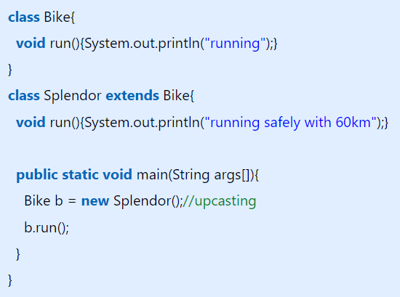
Features of Java
Example of Run Time Polymorphism in Java
In run-time polymorphism, an overridden method is called through the reference variable of a superclass.
The determination of the method to be called is based on the object being referred to by the reference variable.
Upcasting
If the reference variable of Parent class refers to the object of Child class, it is known as upcasting.

Slide 19
Features of Java
Object Oriented Features
Abstraction
Abstraction is a process of hiding the implementation details and showing only functionality to the user.
Another way, it shows only essential things to the user and hides the internal details,
For example: We all visit the ATM machine for withdrawing cash and several other things as well, but we never get to know what happens internally inside the machine when we insert our ATM card for any operation, This can be seen as abstraction in real life.
In java programming language the interface and abstract class are used to attain abstraction.

Slide 20
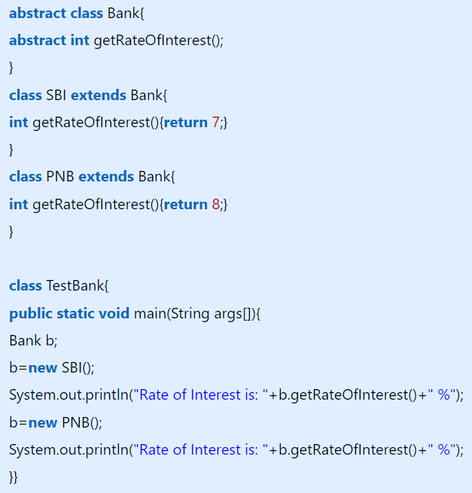
Features of Java
How To Achieve Abstraction in Java?
Two ways to achieve abstraction in java
  Abstract class (0 to 100%)
  Interface (100%)
A class which is declared as abstract is known as an abstract class.
It can have abstract and non-abstract methods. It needs to be extended and its method implemented.
It cannot be instantiated.
A method which is declared as abstract and does not have implementation is known as an abstract method.

Slide 21
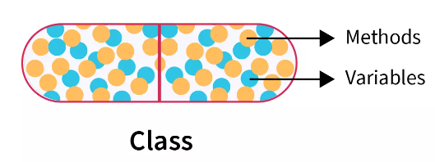
Features of Java
Object Oriented Features
Encapsulation
Encapsulation in Java is a process of wrapping code and data together into a single unit,
In the Java language, the java class is a major example of encapsulation.
Example: The way a capsule encloses all the contents of the medicine in a similar way when we wrap up data members and methods inside a class we can term it to be encapsulation.
We can create a fully encapsulated class in Java by making all the data members of the class private. Now we can use setter and getter methods to set and get the data in it.
Java bean is noticed to be fully encapsulated and this is because all the data members are observed to be private here.

Slide 22
Features of Java
Advantages of Encapsulation
It provides you the control over the data. Suppose you want to set the value of id which should be greater than 100 only, ou can write the logic not to store the negative numbers in the setter methods.
It is a way to achieve data hiding in Java because other class will not be able to access the data through the private data members.
By providing only a setter or getter method, you can make the class read-only or write-only.
The standard IDE's are providing the facility to generate the getters and setters. So, it is easy and fast to create an encapsulated class in Java.

Slide 23
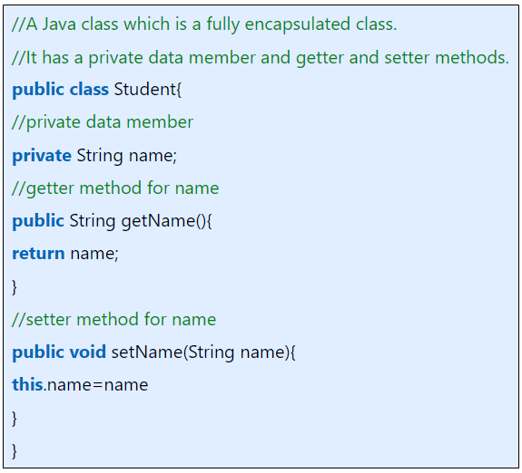
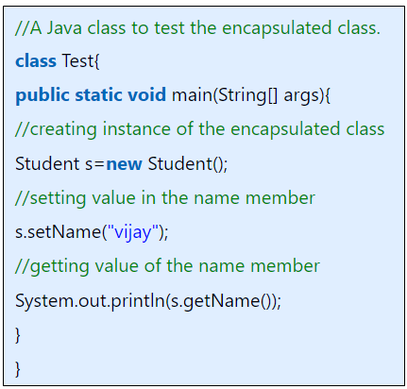
Features of Java
Encapsulation Example : A Fully Encapsulated Class
Output : vijay

Slide 24
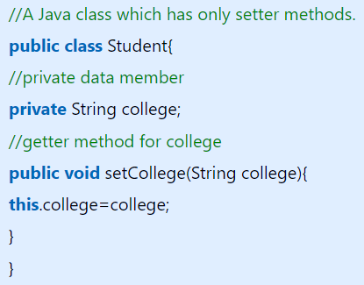
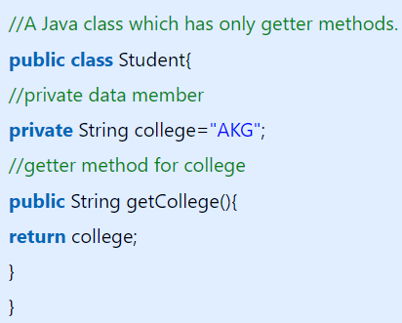

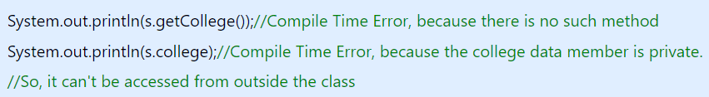
Features of Java
Read Only Java Class
Write Only Java Class
Now, you can't change the value of the college data member which is "AKG".
Now, you can't get the value of the college, you can only change the value of college data member.

Slide 25
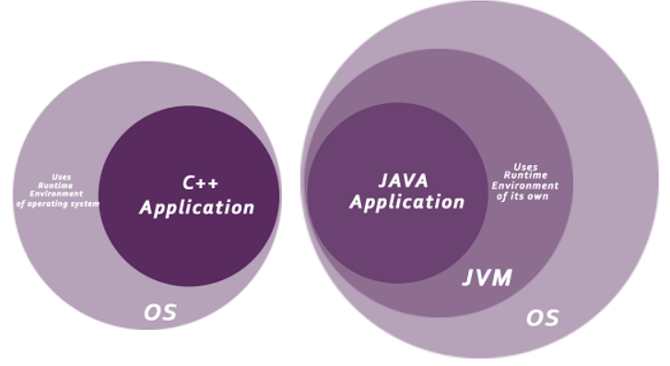
Features of Java
3. Secure Language: Java turns out to be very secure and that is because we do not have access to pointers here, due to the lack of pointers we are unable to get access to outbound arrays and this makes it impossible for the flaws like buffer overflow
Java is best known for its security.
With Java, we can develop virus-free systems.
Java is secured because:
-- No explicit pointer
-- Java Programs run inside a virtual
machine sandbox

Slide 26
Features of Java
4. Architecture-neutral
Java is architecture neutral because there are no implementation dependent features, for example, the size of primitive types is fixed.
In C programming, int data type occupies 2 bytes of memory for 32-bit architecture and 4 bytes of memory for 64-bit architecture.
However, in java, it occupies 4 bytes of memory for both 32 and 64-bit architectures in Java.

Slide 27
Features of Java
5. Distributed Language
Java is distributed because it facilitates users to create distributed applications in Java.
RMI and EJB are used for creating distributed applications.
This feature of Java makes us able to access files by calling the methods from any machine on the internet.
6. Multi-threaded Language
A thread is like a separate program, executing concurrently.
We can write Java programs that deal with many tasks at once by defining multiple threads.
The main advantage of multi-threading is that it doesn't occupy memory for each thread.
It shares a common memory area. Threads are important for multi-media, Web applications etc.

Slide 28
Some Important Java Terminology
Java Development Kit(JDK)
As the name formally states Java development kit is a full-time kit.
The JDK contains a private Java Virtual Machine (JVM) and a few other resources such as an interpreter/loader (java), a compiler (javac), an archiver (jar), a documentation generator (Javadoc), etc. to complete the development of a Java Application.
For program execution in java, we need to have JDK installed on our computers to further lead to the creation, compilation, and running of the java program.
Here, as we use JDK, we need an environment to run the programs.
We use JRE Java Runtime Environment which provides the least requirements to execute the java program. It provides the JVM, Core classes, and supporting files.

Slide 29
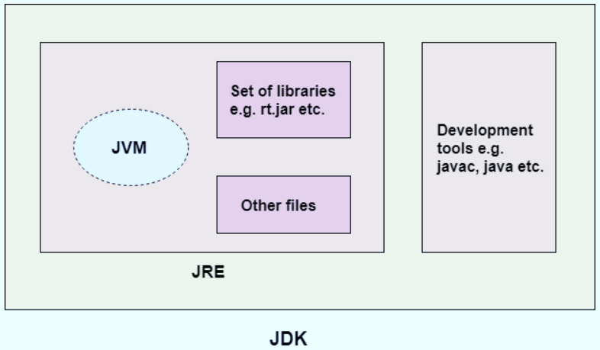
Some Important Java Terminology
Java Development Kit(JDK)

Slide 30
Some Important Java Terminology
Java Runtime Environment(JRE)
Here JDK includes JRE. Which in turn after installation allows the java program to run.
JRE is made up of multiple elements altogether and they are:
  Java virtual machine (JVM)
  Java class libraries
  Java class loader
It is also written as Java RTE. The Java Runtime Environment is a set of software tools which are used for developing Java applications.
It is used to provide the runtime environment.
It is the implementation of JVM that physically exists.
It contains a set of libraries + other files that JVM uses at runtime.

Slide 31
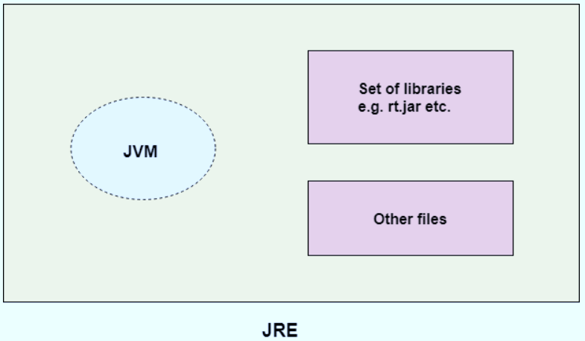
Some Important Java Terminology
Java Runtime Environment(JRE)

Slide 32
Some Important Java Terminology
Java Virtual Machine(JVM)
This generally is referred to as JVM and contains three phases that we have to follow.
It is a very important part not only of JDK but also JRE as it is inbuilt in both of the places.
When you run a program using the JRE and JDK it also goes to the JVM as it is required to run the java program and it also interprets the program.
The phases are as follows:
Compile the Code: The Java Development Kit(JDK) provides us with the JAVAC compiler to get through this step. we basically require the jdk to convert our source code into a specific format that can be easily executed by the Java Runtime Environment(JRE).
Run the Code: JVM runs the bytecode that is provided by the compiler. Since we have always been told Java is a platform-independent language, the output produced by the JVM is easily executable on any machine and this is the reason behind Java being platform Independent.

Slide 33
Some Important Java Terminology
Java Virtual Machine(JVM)
JVMs are available for many hardware and software platforms.
JVM, JRE, and JDK are platform dependent because the configuration of each OS is different from each other.
However, Java is platform independent.
There are three notions of the JVM:
  Specification
  Implementation
  Instance

Slide 34
Some Important Java Terminology
Java Virtual Machine(JVM)
A specification where working of Java Virtual Machine is specified. But implementation provider is independent to choose the algorithm. Its implementation has been provided by Oracle and other companies.
An implementation Its implementation is known as JRE (Java Runtime Environment).
Runtime Instance Whenever you write java command on the command prompt to run the java class, an instance of JVM is created.

Slide 35
Some Important Java Terminology
Java Virtual Machine(JVM)
The JVM performs following operation:
Loads code
Verifies code
Executes code
Provides runtime environment

Slide 36
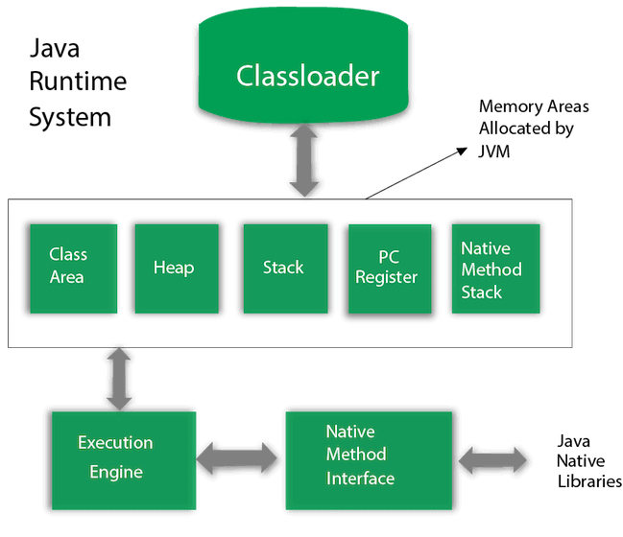
JVM Architecture
Let's understand the internal architecture of JVM. It contains classloader, memory area, execution engine etc.

Slide 37
Some Important Java Terminology
Java Virtual Machine(JVM)
Classloader
Classloader is a subsystem of JVM which is used to load class files. Whenever we run the java program, it is loaded first by the classloader. There are three built-in classloaders in Java.
Bootstrap ClassLoader: This is the first classloader which is the super class of Extension classloader. It loads the rt.jar file which contains all class files of Java Standard Edition like java.lang package classes, java.net package classes, java.util package classes, java.io package classes, java.sql package classes etc.
Extension ClassLoader: This is the child classloader of Bootstrap and parent classloader of System classloader. It loades the jar files located inside $JAVA_HOME/jre/lib/ext directory.
System/Application ClassLoader: This is the child classloader of Extension classloader. It loads the classfiles from classpath. By default, classpath is set to current directory. You can change the classpath using "-cp" or "-classpath" switch. It is also known as Application classloader.

Slide 38
Some Important Java Terminology
Java Virtual Machine(JVM)
2) Class(Method) Area
Class(Method) Area stores per-class structures such as the runtime constant pool, field and method data, the code for methods.
3) Heap
It is the runtime data area in which objects are allocated.
4) Stack
Java Stack stores frames. It holds local variables and partial results, and plays a part in method invocation and return.
Note: Each thread has a private JVM stack, created at the same time as thread.
A new frame is created each time a method is invoked. A frame is destroyed when its method invocation completes.

Slide 39
Some Important Java Terminology
Java Virtual Machine(JVM)
5) Program Counter Register
PC (program counter) register contains the address of the Java virtual machine instruction currently being executed.
6) Native Method Stack
It contains all the native methods used in the application.

Slide 40
Some Important Java Terminology
Java Virtual Machine(JVM)
7) Execution Engine
It contains:
A virtual processor
Interpreter: Read bytecode stream then execute the instructions.
Just-In-Time(JIT) compiler: It is used to improve the performance. JIT compiles parts of the byte code that have similar functionality at the same time, and hence reduces the amount of time needed for compilation. Here, the term "compiler" refers to a translator from the instruction set of a Java virtual machine (JVM) to the instruction set of a specific CPU.

Slide 41
Some Important Java Terminology
Java Virtual Machine(JVM)
8) Java Native Interface
Java Native Interface (JNI) is a framework which provides an interface to communicate with another application written in another language like C, C++, Assembly etc. Java uses JNI framework to send output to the Console or interact with OS libraries.

Slide 42
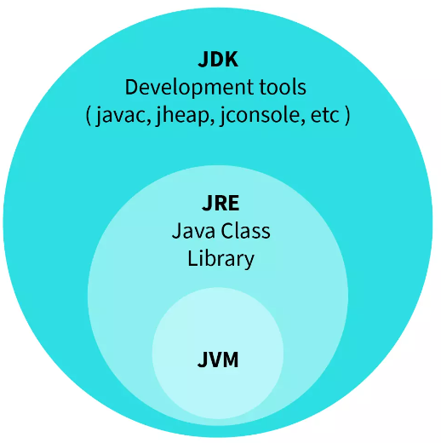
Some Important Java Terminology
Bytecode in the Development Process:
The source code that is provided to the JAVAC compiler that is present in JDK gets compiled into a bytecode which can be executed by the JVM.
It gets saved as a .class file by the compiler itself.
we can also view this bytecode using a disassembler like javap.

Slide 43
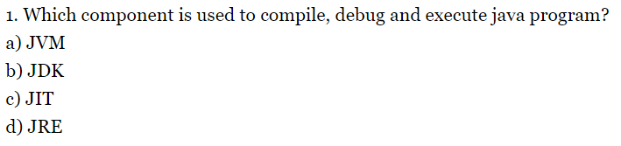
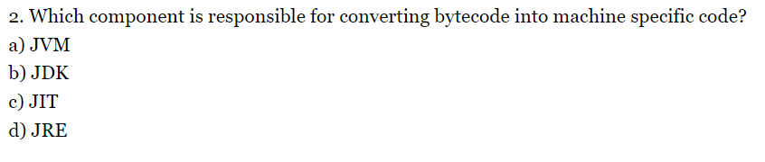
MCQs:

Slide 44
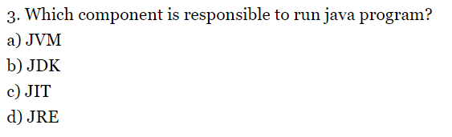
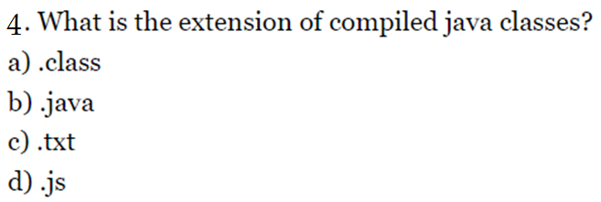
MCQs:

Slide 45
MCQs:
5. Which environment variable is used to set the java path?
a) MAVEN_Path
b) JavaPATH
c) JAVA
d) JAVA_HOME
6) _____ is used to find and fix bugs in the Java programs.
JVM
JRE
JDK
JDB

Slide 46
MCQs:
7. What are the main operations of JVM?
A. 1) To load code 2) To compile code 3) To executes code 4) To provide runtime environment.
B. 1) To compile code 2) To load code 3) To Executes code 4) To provide runtime environment.
C. 1) To debug code 2) To compile code 3) To Executes code 4) To provide runtime environment.
D. 1) To load code 2) To Verify code 3) To Executes code 4) To provide runtime environment.
8. Which of the following is not a part of JRE?
JVM
Java Class Libraries
Javac
Achieve .jar files

Slide 47
MCQs:
9. Which one of the following is not a feature of Java?
a) Object-oriented
b) Use of pointers
c) Portable
d) Dynamic and Extensible
Q10. Which of the following option leads to the portability and security of Java?
a) Bytecode is executed by JVM
b) The applet makes the Java code secure and portable
c) Use of exception handling
d) Dynamic binding between objects

Slide 48
MCQs:
11. Which component is responsible to run java program?
a) JVM
b) JDK
c) JIT
d) JRE

